Slide 1
Predicting best location for continental restaurant in chennai

Slide 2
Importance of location for restaurants
Location is a very important criteria while setting up a restaurant.
A restaurant's closeness to tourist places, offices etc determines the number of patrons it will receive everyday.
A well located restaurant has a big impact on the economy of the city as well.

Slide 3
Data acquisition and cleaning
The data for this analysis was acquired from a Zomato Kaggle dataset containing required information such as restaurant locality, ratings, cuisines etc.
This data was cleaned by dropping unwanted columns such as country, has table seating etc. This reduced the number of columns in dataset to 8 thereby making it easier to analyse the given data.

Slide 4
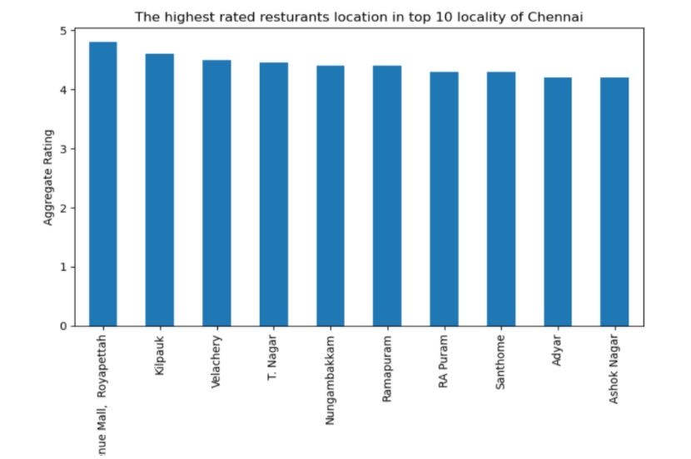
Best rated restaurants in chennai

Slide 5
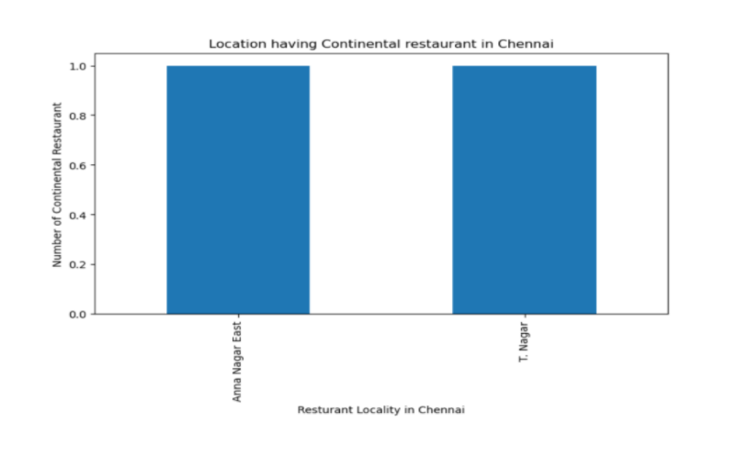
Continental restaurants in chennai

Slide 6
Check nearby venues
Foursquare API was used to calculate and compare the nearby venues for each restaurant location.
This is important as the presence of attractions/tourist venues will boost the sales of a restaurant, hence helping to select the best location.

Slide 7
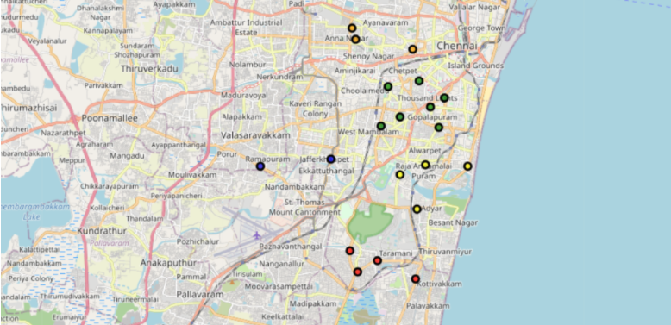
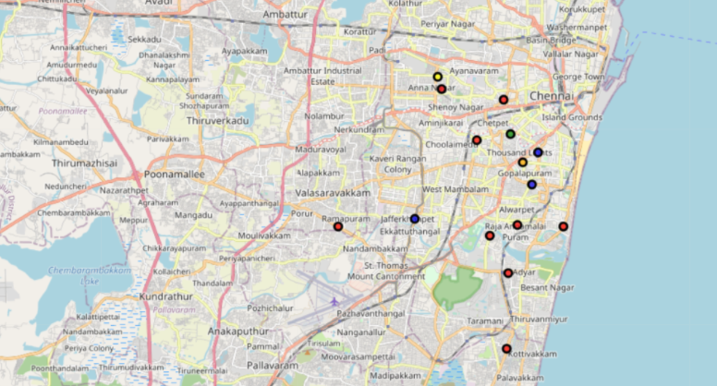
Location comparision
Before using Foursquare
After using Foursquare

Slide 8
Conclusion
Using all of the above data, it can be observed that out of the 2 continental restaurants already present in Chennai, only 1 (T Nagar) in among the top 10 rated.
If we then compare the cluster with the most nearby venues to areas with best rated restaurants in the city, Adyar seems to be a good choice to start a new Continental restaurant in Chennai.

